Slide 1

Building Early Literacy
and Strong Families
with Raising a Reader
Presented by:
Date:

Slide 2
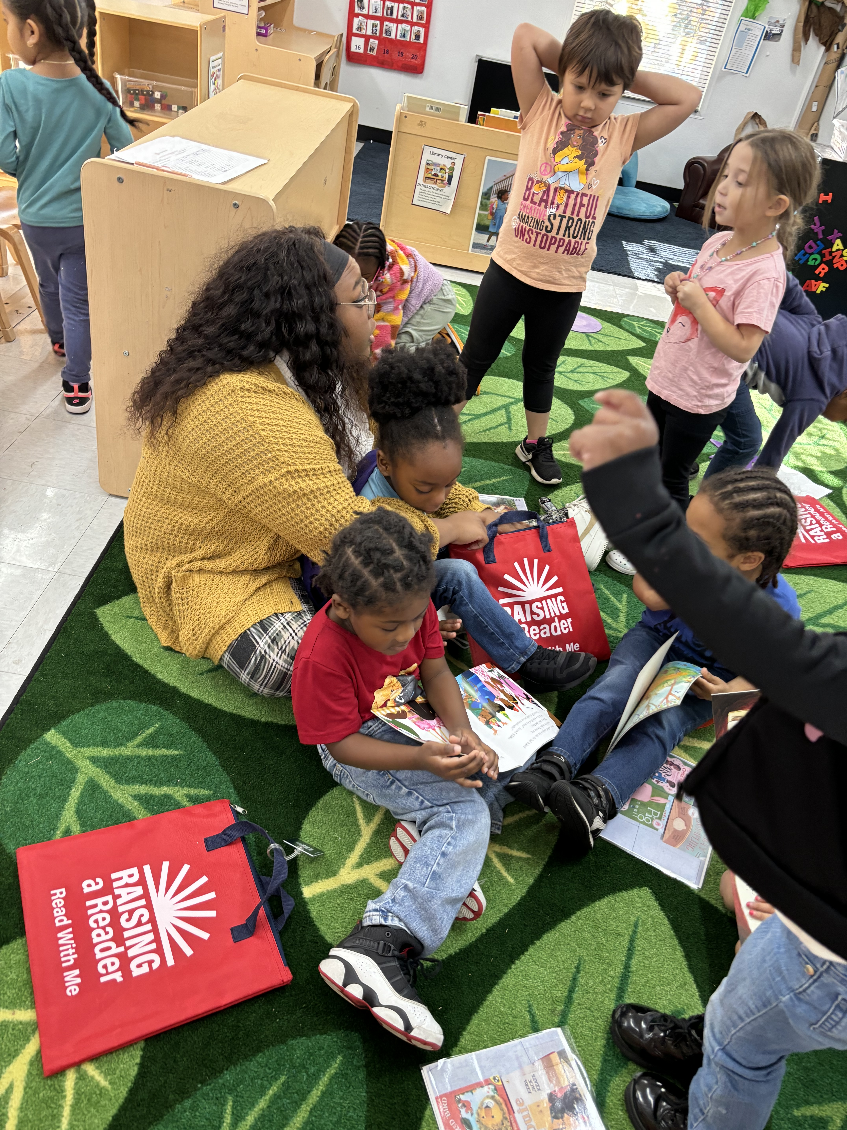

About Raising a Reader
Raising a Reader is a national early literacy and family engagement organization with a simple, powerful mission:
foster healthy brain development
strengthen family bonds
build early literacy skills by encouraging shared reading routines at home
Optional: Add 1-2 sentences about your local Affiliate's role (example: "Since [Year], [Affiliate Name] has proudly brought Raising a Reader to families across [County/City Name].")

Slide 3


Early Reading Builds Lifelong Success
Children who are read to regularly perform better in school.
Early language skills are a key predictor of academic achievement.
Family engagement through reading strengthens emotional bonds.
Reading proficiency by 3rd grade predicts high school graduation rates.

Slide 4
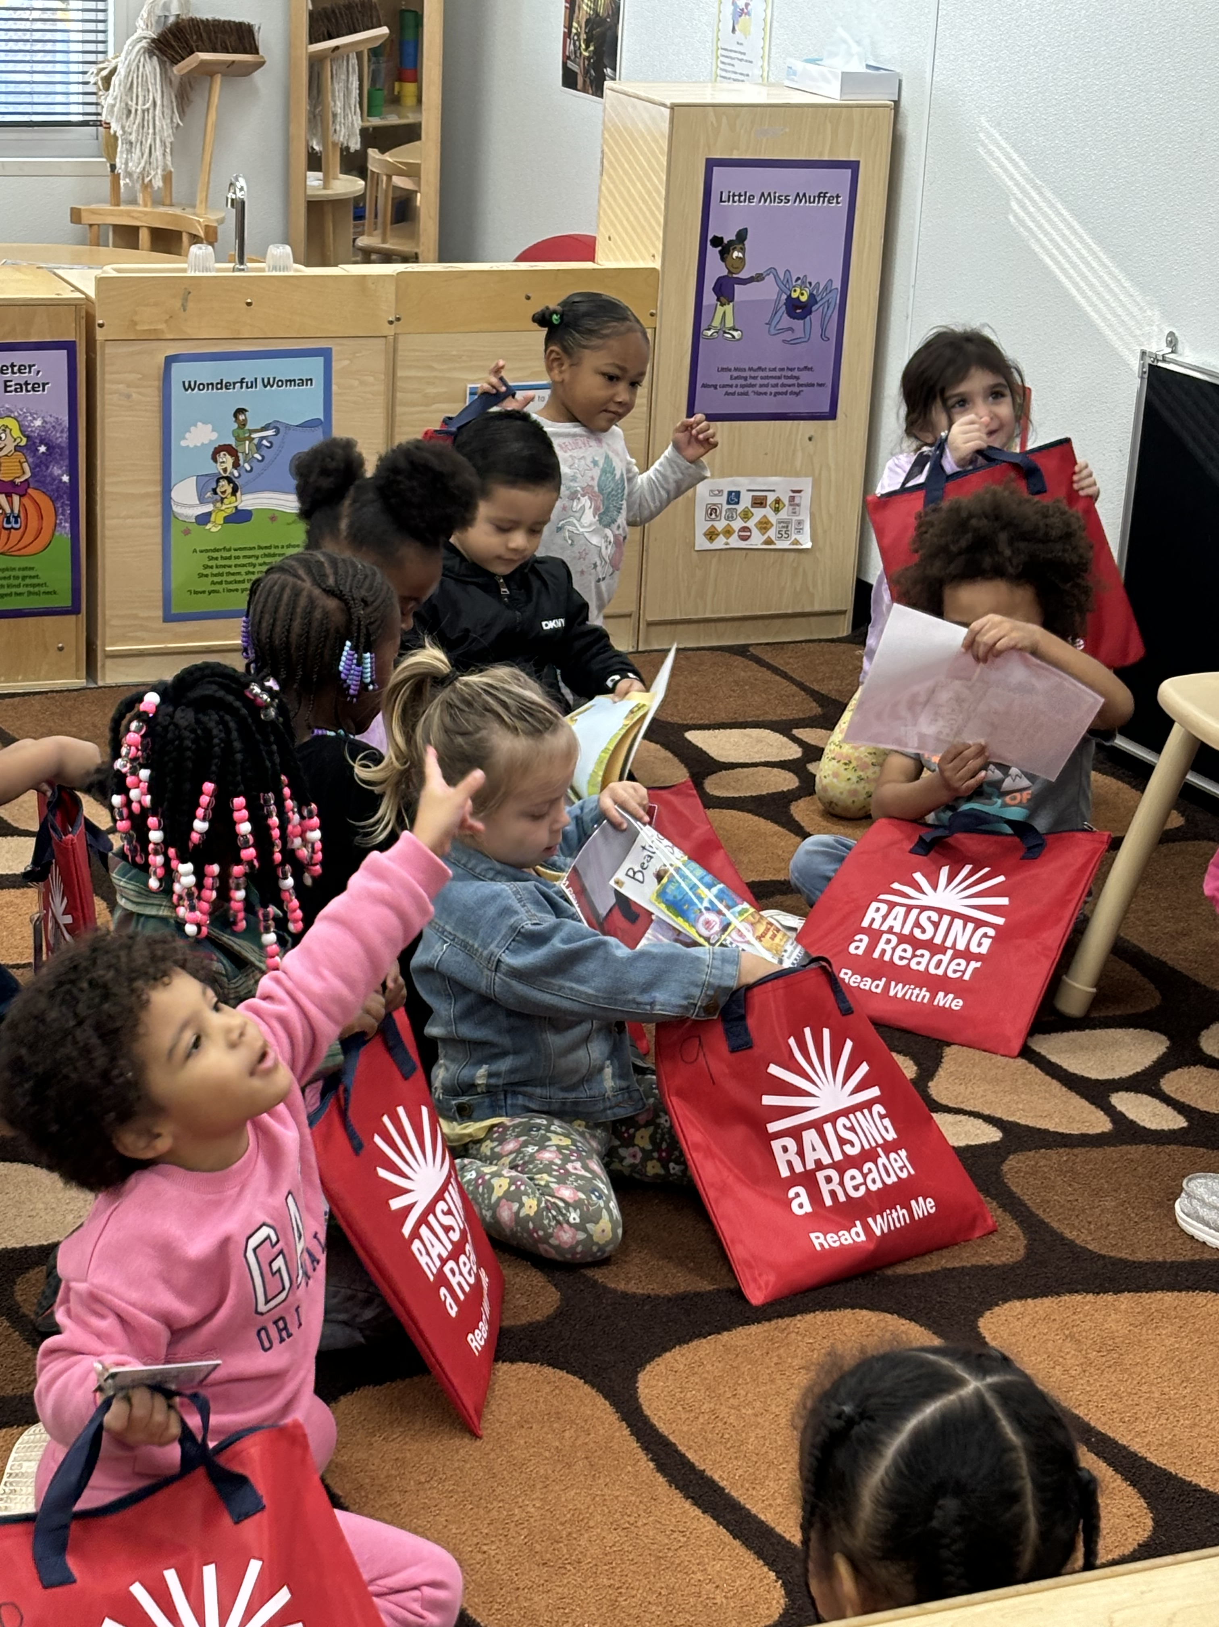
Customize for your program. IE: Classic Red Book Bag
Four step model:
Rotate Books: Children take home a new bag of books each week.
Engage Families: Parents and caregivers are supported to develop reading routines.
Expand Access: Families are connected to libraries and encouraged to continue the reading habit.
Celebrate Reading: Communities celebrate participation and progress
Before Raising a Reader

Slide 5

Community Impact
Before Raising a Reader
XXXX
Implementing Sites
XXXX
Children/Families Served
XXXX
Books Distributed
XXXX
Years in Operation

Slide 6
Stories from Our Families
Short family success story, e.g.,
"The Smith family shared that the weekly book rotation helped them create a nightly reading routine that continues today."

Slide 7
Investing in Early Literacy Pays Off
Supports school readiness and long-term educational outcomes.
Strengthens families and communities.
Reduces the need for costly remedial education later.
Every $1 invested in early literacy yields up to
in long-term savings.
$13

Slide 8
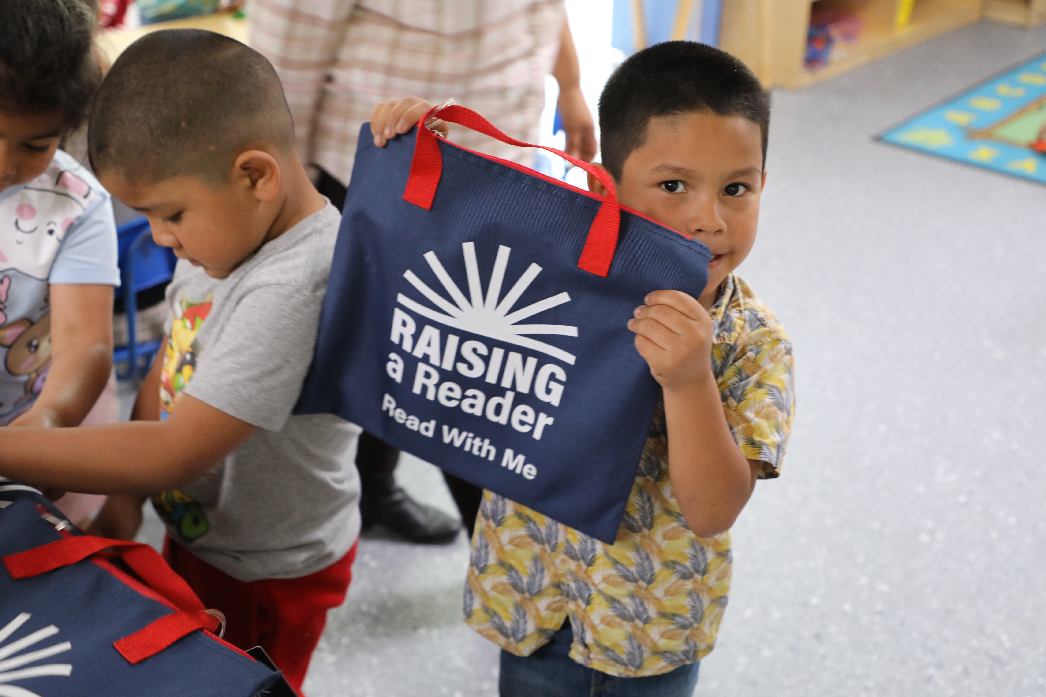

How You Can Help
Fund Program Expansion: Reach more children and families.
Sponsor Book Bags: Provide a set of books for a classroom.
Support Family Workshops: Help deliver parent engagement sessions.
LOCAL CALL TO ACTION

Slide 9
THANK YOU!
[Affiliate Contact Name]
[Phone Number]
[Email Address]
[Website or Social Media Handles]

